Slide 1

JC3504 Robot Technology
Lecture 12: Localisation

Slide 2
Outline
Markov Localisation
The Bayes Filter
Particle Filter
Kalman Filter
Kalman Filter 1-D Example
Kalman Filter (Simplified)
Kalman Filter (full-version)

Slide 3
Localisation
Localisation in robotics involves the determination of a robot's position and orientation within its environment, utilising various sensors and algorithms to enable accurate navigation and interaction with surroundings.
The primary challenge of localisation in robotics lies in achieving accurate and robust position estimation amidst dynamic environments, sensor noise, and the inherent uncertainty of real-world settings.

Slide 4


Motivating Example
Imagine a floor with three doors, two of which are closer together, and the third farther down the corridor. Imagine now that your robot is able to detect doors i.e. it is able to tell whether it is in front of a wall or in front of a door. Features like this can serve as a landmark for the robot.

Slide 5
Motivating Example
Given the map of the environment but no information about the robot's location, we can use landmarks to drastically reduce the space of possible locations once the robot has passed one of the doors. When a robot passes through a door, it cannot ascertain which door it has passed through, but it knows it is in front of a door; hence, its estimation of its own position is as follows.
The location possibility distribution

Slide 6
Motivating Example
One way of representing this belief is to describe the robot’s position with three Gaussian distributions, each centred in front of a door and its variance a function of the uncertainty with which the robot can detect a door’s centre.
This is known as a multi-hypothesis belief, since we have a hypothesis stating that the robot can be in front of each door.
The location possibility distribution

Slide 7
Motivating Example
If the robot continues to move, according to the error propagation law:
The Gaussians describing the robot’s 3 possible locations will move with the robot.
The variance of each Gaussian will keep increasing with the distance the robot moves.
The location possibility distribution

Slide 8
Motivating Example
Assuming we trust our door detector much more than our odometry estimate, we can now remove all beliefs that do not coincide with a door.
Again assuming our door detector can detect the centre of a door with some accuracy, our location estimate’s uncertainty is now only limited by that of the door detector.
The location possibility distribution

Slide 9
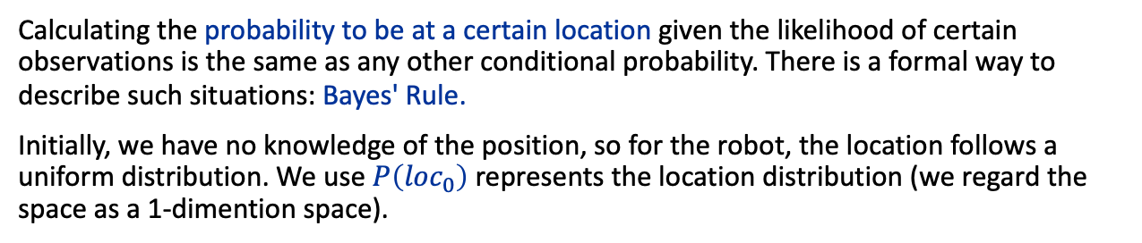

Markov Localisation
Calculating the probability to be at a certain location given the likelihood of certain observations is the same as any other conditional probability. There is a formal way to describe such situations: Bayes' Rule.
Initially, we have no knowledge of the position, so for the robot, the location follows a uniform distribution. We use $P\left({loc}_{0}\right)$ represents the location distribution (we regard the space as a 1-dimention space).
The location possibility distribution
($P\left(loc_{0}\right)$ is a uniform distribution)

Slide 10
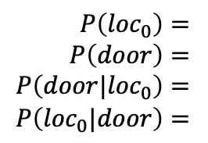
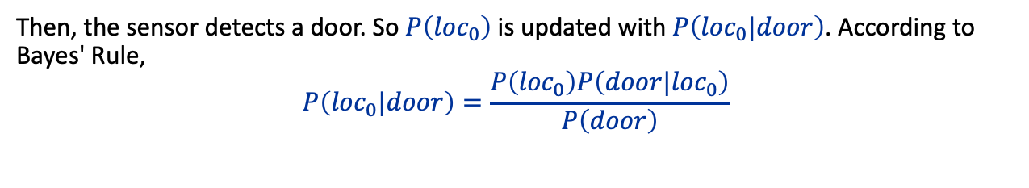
Markov Localisation
Then, the sensor detects a door. So $P\left({loc}_{0}\right)$ is updated with $P\left({loc}_{0}|door\right)$. According to Bayes' Rule,
$$P\left({loc}_{0}|door\right)=\frac{P\left({loc}_{0}\right)P\left(door|{loc}_{0}\right)}{P\left(door\right)}$$
$P\left({loc}_{0}\right)=$
$P\left(door\right)=$
$P\left(door|{loc}_{0}\right)=$
$P\left({loc}_{0}|door\right)=$
The location possibility distribution
Notes:
$P\left(door\right)$ might be the most confusing part of information we need to collect. Here, ‘loc’refers to x axis, $P\left(door\right)$ is independent to x axis, this means the value of $P\left(door\right)$ is the same at every point on x. So, $P\left(door\right)$ is also a uniform distribution.
P is the distribution represented by the probability density function. The multiplication and division of two probability density functions can be expressed by 'or' and 'and' operations, but normalization is required after the calculation, because the integral of the probability density function must be 1.

Slide 11
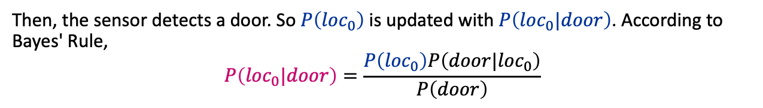
Markov Localisation
Then, the sensor detects a door. So $P\left({loc}_{0}\right)$ is updated with $P\left({loc}_{0}|door\right)$. According to Bayes' Rule,
$$P\left({loc}_{0}|door\right)=\frac{P\left({loc}_{0}\right)P\left(door|{loc}_{0}\right)}{P\left(door\right)}$$
prior probability
posterior probability
The location possibility distribution
Notes:
$P\left(door\right)$ might be the most confusing part of information we need to collect. Here, ‘loc’refers to x axis, $P\left(door\right)$ is independent to x axis, this means the value of $P\left(door\right)$ is the same at every point on x. So, $P\left(door\right)$ is also a uniform distribution.
P is the distribution represented by the probability density function. The multiplication and division of two probability density functions can be expressed by 'or' and 'and' operations, but normalization is required after the calculation, because the integral of the probability density function must be 1.

Slide 12

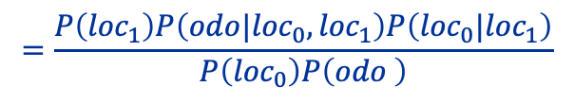
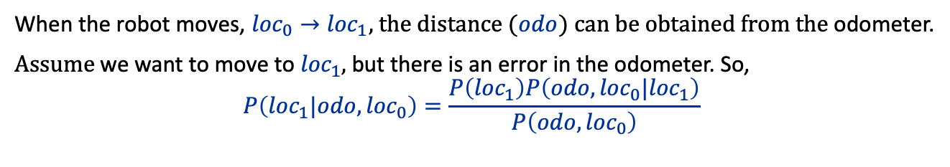
Markov Localisation
When the robot moves, ${loc}_{0}→{loc}_{1}$, the distance ($odo$) can be obtained from the odometer.
Assume we want to move to ${loc}_{1}$, but there is an error in the odometer. So,
$$P\left({loc}_{1}|odo,{loc}_{0}\right)=\frac{P\left({loc}_{1}\right)P\left(odo,{loc}_{0}|{loc}_{1}\right)}{P\left(odo,{loc}_{0}\right)}$$
$$=\frac{P\left({loc}_{1}\right)P\left(odo|{loc}_{0},{loc}_{1}\right)P\left({loc}_{0}|{loc}_{1}\right)}{P\left({loc}_{0}\right)P\left(odo \right)}$$
$$=P\left(odo|{loc}_{0},{loc}_{1}\right)P\left({loc}_{0}|{loc}_{1}\right)$$
The location possibility distribution
Notes:
${loc}_{0}$ and $odo$ are independent, so $P\left(odo,{loc}_{0}\right)=P\left({loc}_{0}\right)P\left(odo \right)$
$P\left({loc}_{0}\right)$, $P\left({loc}_{1}\right)$ and $P\left(odo \right)$ independent to x, so they can be regards as is uniform distributions.

Slide 13
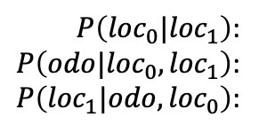
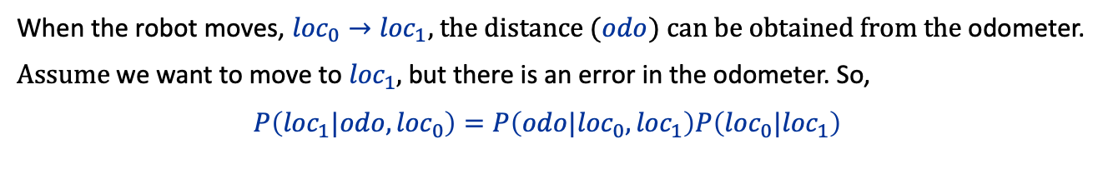
Markov Localisation
When the robot moves, ${loc}_{0}→{loc}_{1}$, the distance ($odo$) can be obtained from the odometer.
Assume we want to move to ${loc}_{1}$, but there is an error in the odometer. So,
$P\left({loc}_{1}|odo,{loc}_{0}\right)=P\left(odo|{loc}_{0},{loc}_{1}\right)P\left({loc}_{0}|{loc}_{1}\right)$
$P\left({loc}_{0}|{loc}_{1}\right)$:
$P\left(odo|{loc}_{0},{loc}_{1}\right)$:
$P\left({loc}_{1}|odo,{loc}_{0}\right)$:
The location possibility distribution

Slide 14
The Bayes Filter

Slide 15




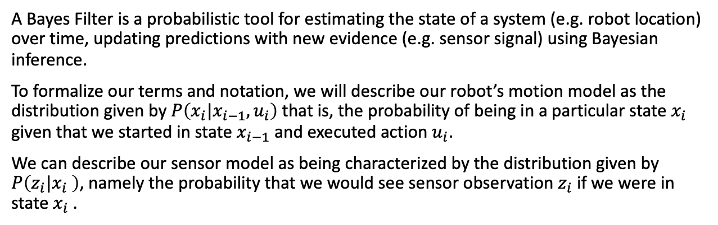






The Bayes Filter
A Bayes Filter is a probabilistic tool for estimating the state of a system (e.g. robot location) over time, updating predictions with new evidence (e.g. sensor signal) using Bayesian inference.
To formalize our terms and notation, we will describe our robot’s motion model as the distribution given by $P\left(x_{i}|x_{i−1},u_{i}\right)$ that is, the probability of being in a particular state $x_{i}$ given that we started in state $x_{i−1}$ and executed action $u_{i}$.
We can describe our sensor model as being characterized by the distribution given by $P\left(z_{i}|x_{i} \right)$, namely the probability that we would see sensor observation $z_{i}$ if we were in state $x_{i}$.
$$u_{1}$$
$$u_{2}$$
$$u_{3}$$
$$u_{4}$$
$$x_{1}$$
$$x_{2}$$
$$x_{3}$$
$$z_{1}$$
$$z_{2}$$
$$z_{3}$$

Slide 16
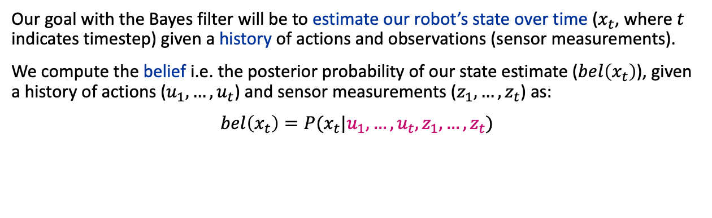
The Bayes Filter
Our goal with the Bayes filter will be to estimate our robot’s state over time ($x_{t}$, where $t$ indicates timestep) given a history of actions and observations (sensor measurements).
We compute the belief i.e. the posterior probability of our state estimate ($bel\left(x_{t}\right)$), given a history of actions ($u_{1},…,u_{t}$) and sensor measurements ($z_{1},…,z_{t}$) as:
$bel\left(x_{t}\right)=P(x_{t}|u_{1},…,u_{t},z_{1},…,z_{t})$
all the historical actions and observations
$$u_{1}$$
$$u_{2}$$
$$u_{3}$$
$$u_{4}$$
$$x_{1}$$
$$x_{2}$$
$$x_{3}$$
$$z_{1}$$
$$z_{2}$$
$$z_{3}$$
Notes:
$\hat{α}\left(x_{t}\right)$ is e.g. the location distribution at time t

Slide 17


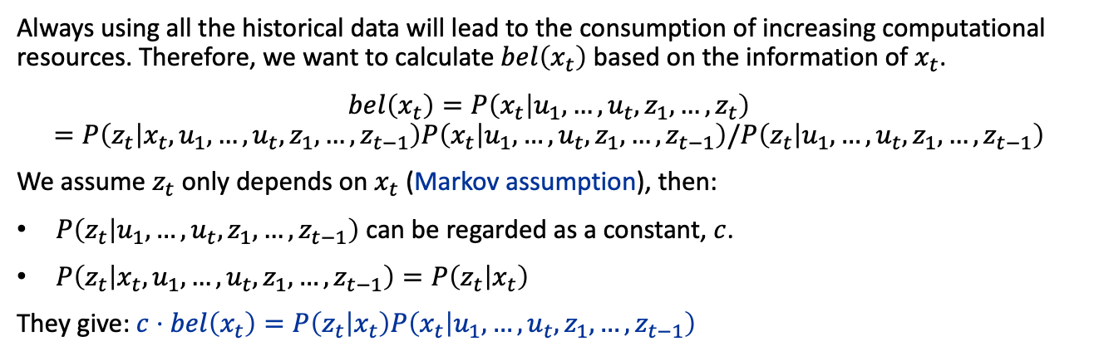








The Bayes Filter
Always using all the historical data will lead to the consumption of increasing computational resources. Therefore, we want to calculate $bel\left(x_{t}\right)$ based on the information of $x_{t}$.
$bel\left(x_{t}\right)=P\left(x_{t} | u_{1},…,u_{t},z_{1},…,z_{t}\right)$
$$=P\left(z_{t} | x_{t},u_{1},…,u_{t},z_{1},…,z_{t−1}\right)P\left(x_{t} | u_{1},…,u_{t},z_{1},…,z_{t−1}\right)/P\left(z_{t} | u_{1},…,u_{t},z_{1},…,z_{t−1}\right)$$
We assume $z_{t}$ only depends on $x_{t}$ (Markov assumption), then:
$P\left(z_{t} | u_{1},…,u_{t},z_{1},…,z_{t−1}\right)$ can be regarded as a constant, $c$.
$P\left(z_{t} | x_{t},u_{1},…,u_{t},z_{1},…,z_{t−1}\right)=P\left(z_{t} | x_{t}\right)$
They give: $c⋅bel\left(x_{t}\right)=P\left(z_{t} | x_{t}\right)P\left(x_{t} | u_{1},…,u_{t},z_{1},…,z_{t−1}\right)$
$$u_{1}$$
$$u_{2}$$
$$u_{3}$$
$$u_{4}$$
$$x_{1}$$
$$x_{2}$$
$$x_{3}$$
$$z_{1}$$
$$z_{2}$$
$$z_{3}$$
Notes:
If we don’t use Markov assumption, $z_{t}$ may depend on $u_{0},…,u_{t}$

Slide 18

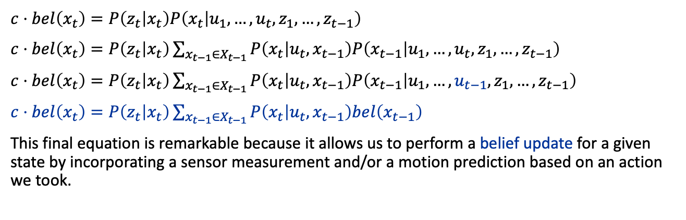




The Bayes Filter
$c⋅bel\left(x_{t}\right)=P\left(z_{t} | x_{t}\right)P\left(x_{t} | u_{1},…,u_{t},z_{1},…,z_{t−1}\right)$
$c⋅bel\left(x_{t}\right)=P\left(z_{t} | x_{t}\right)\sum_{x_{t−1}∈X_{t−1}}{P\left(x_{t} | u_{t}, x_{t−1}\right)P\left(x_{t−1} | u_{1},…,u_{t},z_{1},…,z_{t−1}\right)}$
$c⋅bel\left(x_{t}\right)=P\left(z_{t} | x_{t}\right)\sum_{x_{t−1}∈X_{t−1}}{P\left(x_{t} | u_{t}, x_{t−1}\right)P\left(x_{t−1} | u_{1},…,u_{t−1},z_{1},…,z_{t−1}\right)}$
$c⋅bel\left(x_{t}\right)=P\left(z_{t} | x_{t}\right)\sum_{x_{t−1}∈X_{t−1}}{P\left(x_{t} | u_{t}, x_{t−1}\right)bel\left(x_{t−1}\right)}$
This final equation is remarkable because it allows us to perform a belief update for a given state by incorporating a sensor measurement and/or a motion prediction based on an action we took.
$$u_{1}$$
$$u_{2}$$
$$u_{3}$$
$$u_{4}$$
$$x_{1}$$
$$x_{2}$$
$$x_{3}$$
$$z_{1}$$
$$z_{2}$$
$$z_{3}$$

Slide 19
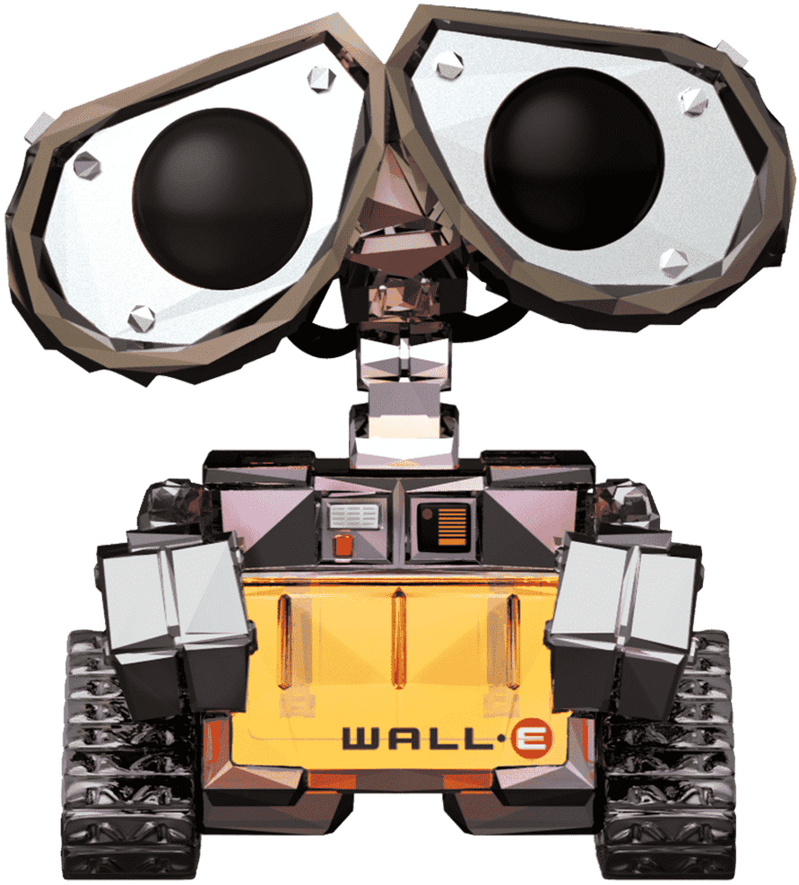
Example: Bayes Filter on a Grid
Instead of using a coarse topological map, we can model the environment as a fine-grained grid. We assume that the robot is able to detect walls around it with short-range sensors.

Slide 20
Example: Bayes Filter on a Grid
Initially, the robot does not see a wall and therefore could be almost anywhere.
real position
estimated position

Slide 21
Example: Bayes Filter on a Grid
The robot now moves. As soon as the robot encounters the wall, the perception update bumps up the likelihood to be higher in grid cells near walls.
real position
estimated position

Slide 22
Example: Bayes Filter on a Grid
The robot then performs a right turn and travels along the wall until hits the wall again.
real position
estimated position

Slide 23
Example: Bayes Filter on a Grid
The robot continuously travels along. when it reaches the gap in the wall, it is almost certain about its position.
real position
estimated position

Slide 24
Particle Filter

Slide 25
Particle Filter
Although grid-based Markov Localisation can provide compelling results, it can be computationally very expensive, particularly when the environment is large, and the resolution of the grid is small. This is in part due to the fact that we need to carry the probability to be at a certain location forward for every cell on the grid, regardless of how small this probability is.
An elegant solution to this problem is the particle filter.

Slide 26
Particle Filter
Initially, we generate a set of particles, each represents a possible initial state of the robot.
5
8
1
0
3
4
2
6
7
9
real position
estimated positions and orientations

Slide 27
Particle Filter
Every time the robot moves, we will move each particle in the exact same way, but add noise to each movement much like we would observe on the real robot. Without a perception update, the particles will spread apart farther and farther.
5
1
0
8
2
3
4
6
9
7
real position
estimated positions and orientations

Slide 28
Particle Filter
When there is new observation data, each particle is given a weight, which reflects the degree to which the state of the particle is consistent with the observation data.
5
1
0
8
2
3
4
6
9
7
real position
estimated positions and orientations

Slide 29
Particle Filter
Particles with low weights will be eliminated and particles with high weights will be copied.
5
a
f
d
b
c
0
8
2
e
real position
estimated positions and orientations

Slide 30
Particle Filter
We repeat this step
5
a
c
b
f
d
2
0
8
e
real position
estimated positions and orientations

Slide 31
Particle Filter
We repeat this step
5
a
c
b
f
d
2
0
8
e
real position
estimated positions and orientations

Slide 32
Particle Filter
We repeat this step
a
i
c
g
b
f
d
h
2
8
real position
estimated positions and orientations

Slide 33
Particle Filter
We repeat this step
c
a
i
d
8
g
f
b
h
2
real position
estimated positions and orientations

Slide 34
Particle Filter
We repeat this step
c
a
i
d
8
g
f
b
h
2
real position
estimated positions and orientations

Slide 35
Particle Filter
After a few more observations, most examples will be located near the correct location of the robot.
k
p
b
n
j
h
2
l
m
o
real position
estimated positions and orientations

Slide 36
Kalman Filter

Slide 37
Kalman Filter
Kalman Filter is an efficient recursive filtering algorithm used for state estimation and control of linear systems.
The Kalman filter uses a dynamic model of the system, combined with past states and current observations, to predict the current state and update the prediction to more accurately reflect the real situation.

Slide 38
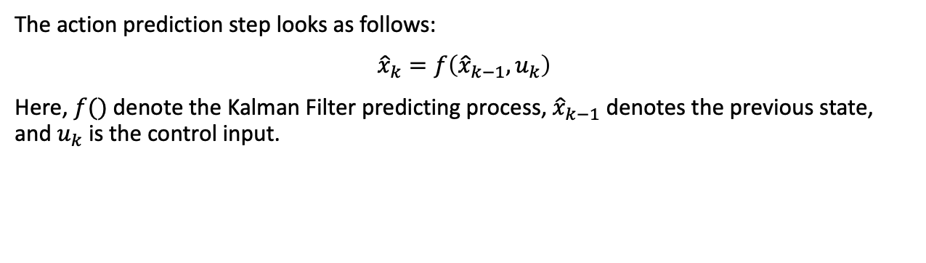


Kalman Filter
The action prediction step looks as follows:
${\hat{x}}_{k}=f\left({\hat{x}}_{k−1}, u_{k}\right)$
Here, $f()$ denote the Kalman Filter predicting process, ${\hat{x}}_{k−1}$ denotes the previous state, and $u_{k}$ is the control input.
$$u_{1}$$
$$u_{2}$$
$$u_{3}$$
$$u_{4}$$
$$x_{1}$$
$$x_{2}$$
$$x_{3}$$
$$z_{1}$$
$$z_{2}$$
$$z_{3}$$

Slide 39
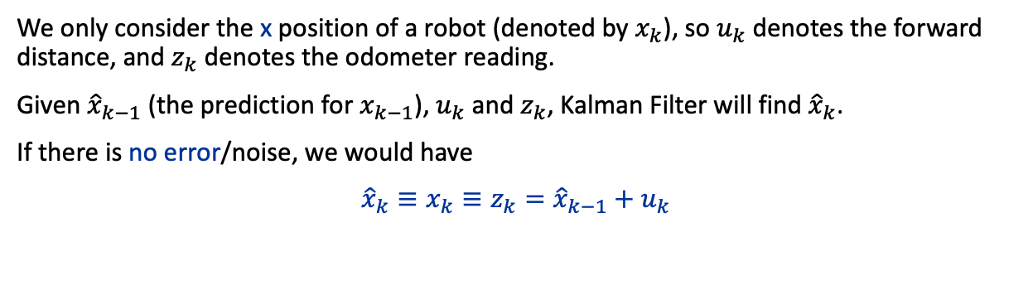
Kalman Filter 1-D Example
We only consider the x position of a robot (denoted by $x_{k}$), so $u_{k}$ denotes the forward distance, and $z_{k}$ denotes the odometer reading.
Given ${\hat{x}}_{k−1}$ (the prediction for $x_{k−1}$), $u_{k}$ and $z_{k}$, Kalman Filter will find ${\hat{x}}_{k}$.
If there is no error/noise, we would have
${\hat{x}}_{k}≡x_{k}≡z_{k}={\hat{x}}_{k−1}+u_{k}$
$$u_{1}$$
$$u_{2}$$
$$u_{3}$$
$$u_{4}$$
$$x_{1}$$
$$x_{2}$$
$$x_{3}$$
$$z_{1}$$
$$z_{2}$$
$$z_{3}$$

Slide 40
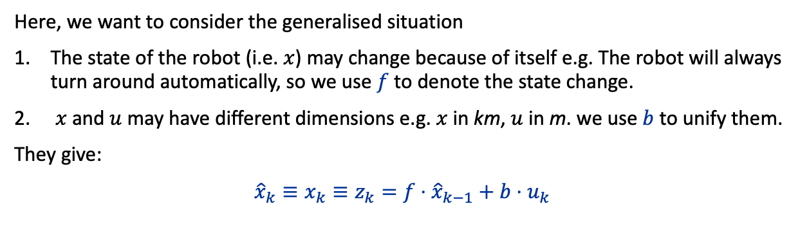
Kalman Filter 1-D Example
Here, we want to consider the generalised situation
The state of the robot (i.e. $x$) may change because of itself e.g. The robot will always turn around automatically, so we use $f$ to denote the state change.
$x$and $u$ may have different dimensions e.g. $x$ in km, $u$ in m. we use $b$ to unify them.
They give:
${\hat{x}}_{k}≡x_{k}≡z_{k}=f⋅{\hat{x}}_{k−1}+b⋅u_{k}$
If there is no error/noise, the prediction is very simple.
$$u_{1}$$
$$u_{2}$$
$$u_{3}$$
$$u_{4}$$
$$x_{1}$$
$$x_{2}$$
$$x_{3}$$
$$z_{1}$$
$$z_{2}$$
$$z_{3}$$

Slide 41
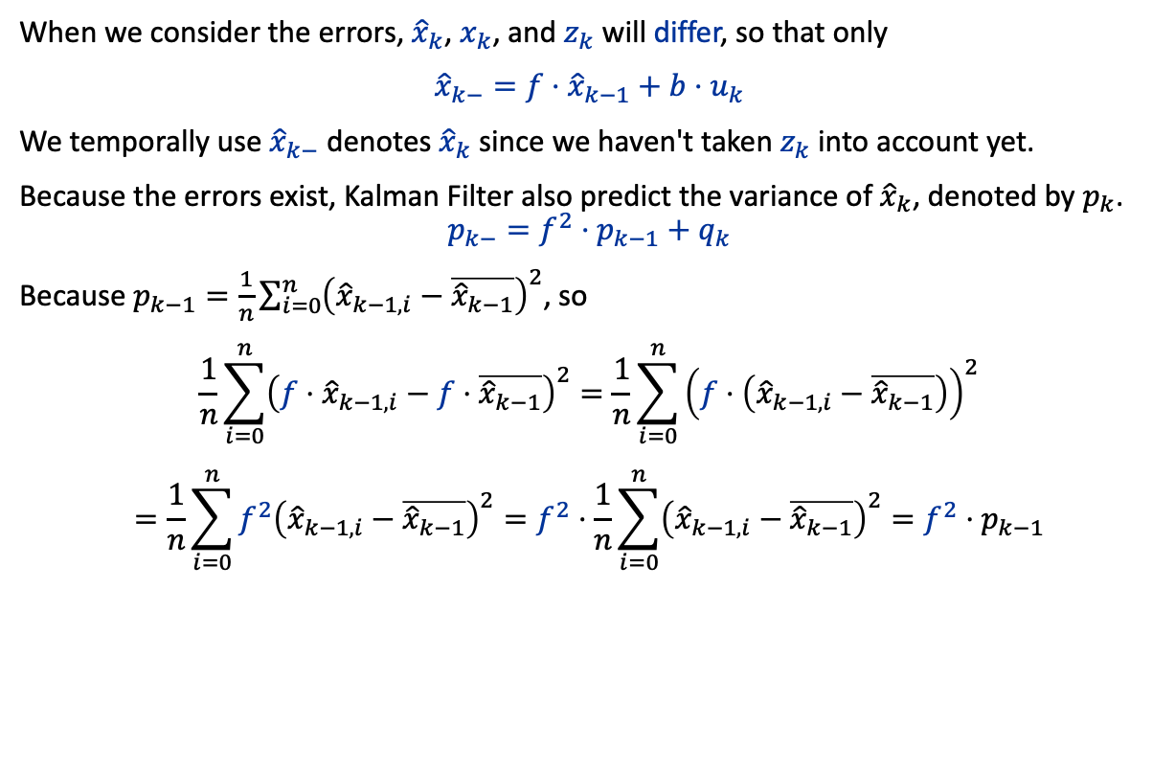
Kalman Filter 1-D Example
When we consider the errors, ${\hat{x}}_{k}$, $x_{k}$, and $z_{k}$ will differ, so that only
${\hat{x}}_{k−}=f⋅{\hat{x}}_{k−1}+b⋅u_{k}$
We temporally use ${\hat{x}}_{k−}$ denotes ${\hat{x}}_{k}$ since we haven't taken $z_{k}$ into account yet.
Because the errors exist, Kalman Filter also predict the variance of ${\hat{x}}_{k}$, denoted by $p_{k}$.
$$p_{k−}=f^{2}⋅p_{k−1}+q_{k}$$
Because $p_{k−1}=\frac{1}{n}\sum_{i=0}^{n}{{\left({\hat{x}}_{k−1,i}−\overline{{\hat{x}}_{k−1}}\right)}^{2}}$, so
$$\frac{1}{n}\sum_{i=0}^{n}{{\left(f⋅{\hat{x}}_{k−1,i}−f⋅\overline{{\hat{x}}_{k−1}}\right)}^{2}}=\frac{1}{n}\sum_{i=0}^{n}{{\left(f⋅\left({\hat{x}}_{k−1,i}−\overline{{\hat{x}}_{k−1}}\right)\right)}^{2}}=\frac{1}{n}\sum_{i=0}^{n}{{f^{2}\left({\hat{x}}_{k−1,i}−\overline{{\hat{x}}_{k−1}}\right)}^{2}}=f^{2}⋅\frac{1}{n}\sum_{i=0}^{n}{{\left({\hat{x}}_{k−1,i}−\overline{{\hat{x}}_{k−1}}\right)}^{2}}=f^{2}⋅p_{k−1}$$
Notes:
$x_{k}$ becomes unknowable.
$z_{k}$ is observable so can be read directly.

Slide 42
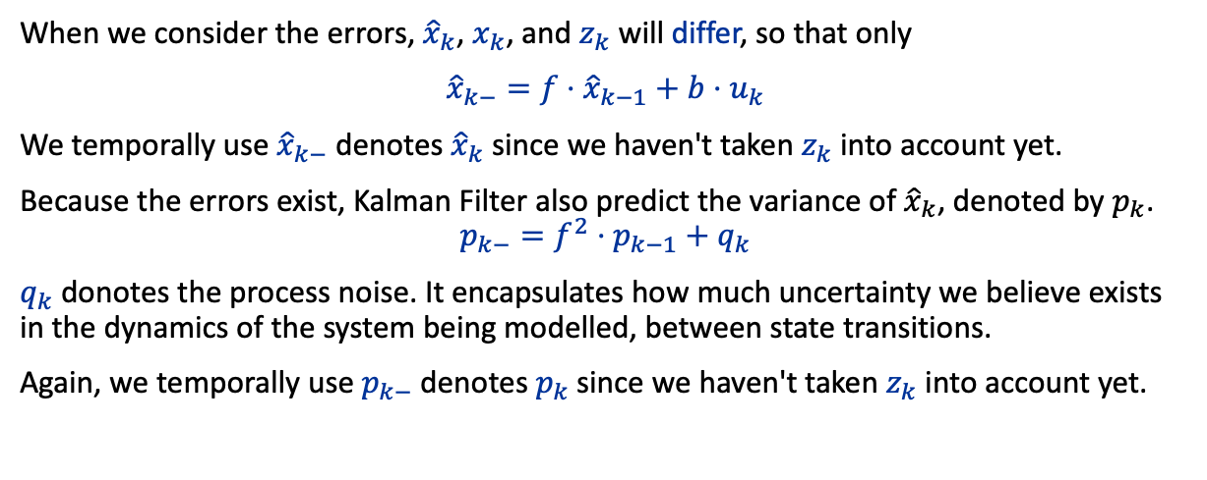
Kalman Filter 1-D Example
When we consider the errors, ${\hat{x}}_{k}$, $x_{k}$, and $z_{k}$ will differ, so that only
${\hat{x}}_{k−}=f⋅{\hat{x}}_{k−1}+b⋅u_{k}$
We temporally use ${\hat{x}}_{k−}$ denotes ${\hat{x}}_{k}$ since we haven't taken $z_{k}$ into account yet.
Because the errors exist, Kalman Filter also predict the variance of ${\hat{x}}_{k}$, denoted by $p_{k}$.
$$p_{k−}=f^{2}⋅p_{k−1}+q_{k}$$
$q_{k}$ donotes the process noise. It encapsulates how much uncertainty we believe exists in the dynamics of the system being modelled, between state transitions.
Again, we temporally use $p_{k−}$ denotes $p_{k}$since we haven't taken $z_{k}$ into account yet.

Slide 43
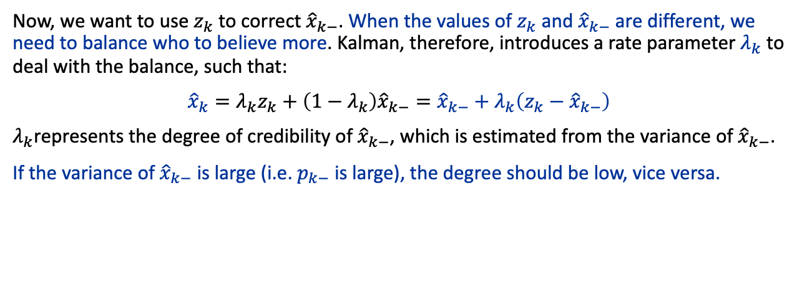
Kalman Filter 1-D Example
Now, we want to use $z_{k}$ to correct ${\hat{x}}_{k−}$. When the values of $z_{k}$ and ${\hat{x}}_{k−}$ are different, we need to balance who to believe more. Kalman, therefore, introduces a rate parameter $λ_{k}$ to deal with the balance, such that:
${\hat{x}}_{k}=λ_{k}z_{k}+\left(1−λ_{k}\right){\hat{x}}_{k−}={\hat{x}}_{k−}+λ_{k}\left(z_{k}−{\hat{x}}_{k−}\right)$
$λ_{k}$represents the degree of credibility of ${\hat{x}}_{k−}$, which is estimated from the variance of ${\hat{x}}_{k−}$.
If the variance of ${\hat{x}}_{k−}$ is large (i.e. $p_{k−}$ is large), the degree should be low, vice versa.

Slide 44
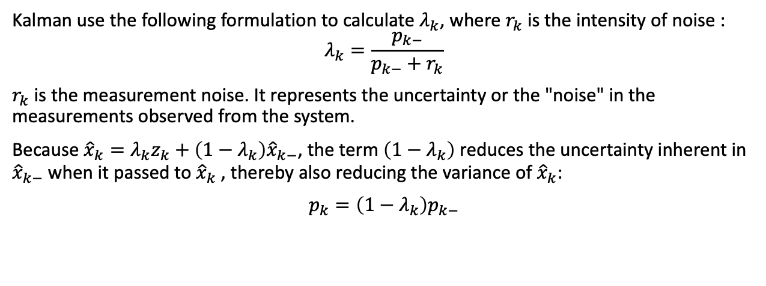
Kalman Filter 1-D Example
Kalman use the following formulation to calculate $λ_{k}$, where $r_{k}$is the intensity of noise :
$$λ_{k}=\frac{p_{k−}}{p_{k−}+r_{k}}$$
$r_{k}$ is the measurement noise. It represents the uncertainty or the "noise" in the measurements observed from the system.
Because ${\hat{x}}_{k}=λ_{k}z_{k}+\left(1−λ_{k}\right){\hat{x}}_{k−}$, the term $\left(1−λ_{k}\right)$ reduces the uncertainty inherent in ${\hat{x}}_{k−}$ when it passed to ${\hat{x}}_{k}$, thereby also reducing the variance of ${\hat{x}}_{k}$:
$$p_{k}=\left(1−λ_{k}\right)p_{k−}$$

Slide 45

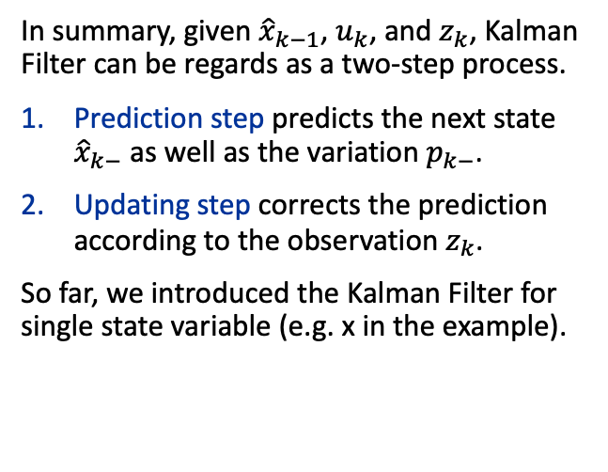







Kalman Filter 1-D Example
State $k−1$
$${\hat{x}}_{k−1}$$
$$p_{k−1}$$
In summary, given ${\hat{x}}_{k−1}$, $u_{k}$, and $z_{k}$, Kalman Filter can be regards as a two-step process.
Prediction step predicts the next state ${\hat{x}}_{k−}$ as well as the variation $p_{k−}$.
Updating step corrects the prediction according to the observation $z_{k}$.
So far, we introduced the Kalman Filter for single state variable (e.g. x in the example).
State $k$
Prediction
$${\hat{x}}_{k−}=f⋅{\hat{x}}_{k−1}+b⋅u_{k}$$
$$p_{k−}=f^{2}⋅p_{k−1}+q_{k}$$
Updating
$$λ_{k}=p_{k−} / \left(p_{k−}+r_{k}\right)$$
$${\hat{x}}_{k}={\hat{x}}_{k−}+λ_{k}\left(z_{k}−{\hat{x}}_{k−}\right)$$
$$p_{k}=\left(1−λ_{k}\right)p_{k−}$$
$$u_{k}$$
$$z_{k}$$
$${\hat{x}}_{k}$$
$$p_{k}$$
State $k+1$

Slide 46
Kalman Filter (Simplified)
If there are multiple state variables, e.g., position x and velocity v, and the variables are not independent of each other, we need to consider their covariance.
NB: If the variables are independent, we just need to calculate them separately.
The covariance is represented as matrix, so the formulars of the 1-D case need to be revised.

Slide 47


Kalman Filter (Simplified)
First, ${\hat{x}}_{k−1}$ will be a vector.
$${\hat{x}}_{k−1}=\left[\begin{aligned}x_{k−1} \\ v_{k−1}\end{aligned}\right]$$
$u_{k}$ may also include multiple variables, so a vector again.
Therefore, $f$ and $b$ become matrix, to be clear, we replace them with $F$ and $B$ .
$$F:\left\{State\right\}→\left\{State\right\}$$
$$B:\left\{Control\right\}→\{State\}$$
They give,
$${\hat{x}}_{k−}=F{\hat{x}}_{k−1}+Bu_{k}$$
For example,
$$F=\left[\begin{matrix}1 & 1 \\ 0 & 1\end{matrix}\right]⟹\left\{\begin{aligned}x_{k}=x_{k−1}+v_{k−1} \\ v_{k}=v_{k−1}\end{aligned}\right.$$
1-D example
Prediction
$${\hat{x}}_{k−}=f⋅{\hat{x}}_{k−1}+b⋅u_{k}$$
$$p_{k−}=f^{2}⋅p_{k−1}+q_{k}$$
Updating
$$λ_{k}=p_{k−} / \left(p_{k−}+r_{k}\right)$$
$${\hat{x}}_{k}={\hat{x}}_{k−}+λ_{k}\left(z_{k}−{\hat{x}}_{k−}\right)$$
$$p_{k}=\left(1−λ_{k}\right)p_{k−}$$

Slide 48
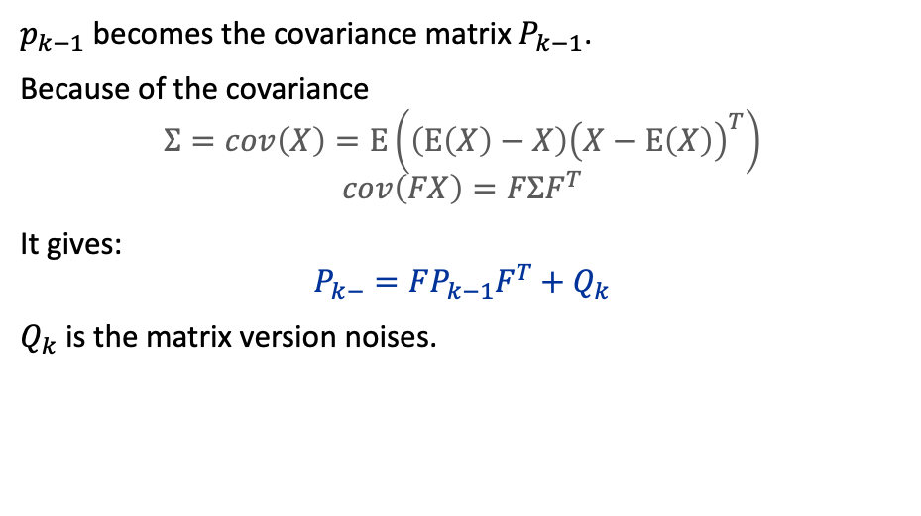
Kalman Filter (Simplified)
$p_{k−1}$ becomes the covariance matrix $P_{k−1}$.
Because of the covariance
$$Σ=cov\left(X\right)=E\left(\left(E\left(X\right)−X\right){\left(X−E\left(X\right)\right)}^{T}\right)$$
$$cov\left(FX\right)=FΣF^{T}$$
It gives:
$$P_{k−}=FP_{k−1}F^{T}+Q_{k}$$
$Q_{k}$ is the matrix version noises.
1-D example
Prediction
$${\hat{x}}_{k−}=f⋅{\hat{x}}_{k−1}+b⋅u_{k}$$
$$p_{k−}=f^{2}⋅p_{k−1}+q_{k}$$
Updating
$$λ_{k}=p_{k−} / \left(p_{k−}+r_{k}\right)$$
$${\hat{x}}_{k}={\hat{x}}_{k−}+λ_{k}\left(z_{k}−{\hat{x}}_{k−}\right)$$
$$p_{k}=\left(1−λ_{k}\right)p_{k−}$$

Slide 49
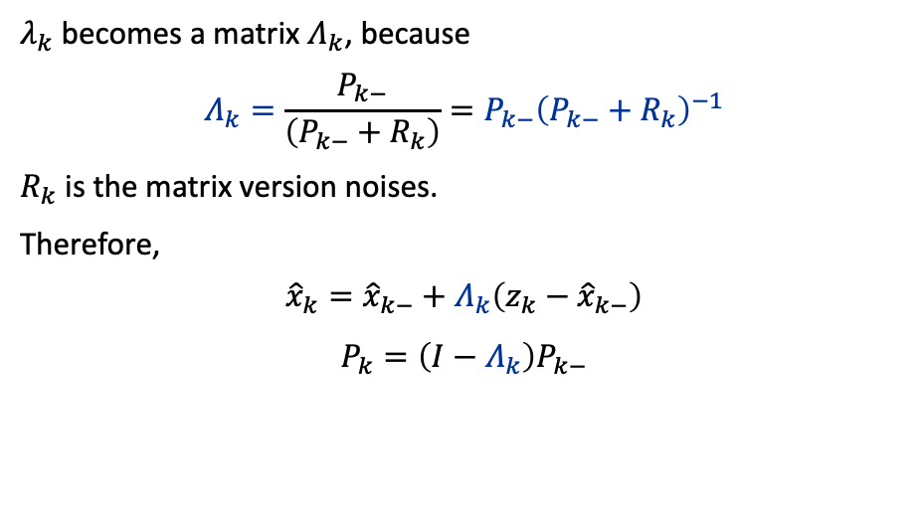
Kalman Filter (Simplified)
$λ_{k}$becomes a matrix $Λ_{k}$, because
$$Λ_{k}=\frac{P_{k−}}{\left(P_{k−}+R_{k}\right)}=P_{k−}{\left(P_{k−}+R_{k}\right)}^{−1}$$
$R_{k}$ is the matrix version noises.
Therefore,
$${\hat{x}}_{k}={\hat{x}}_{k−}+Λ_{k}\left(z_{k}−{\hat{x}}_{k−}\right)$$
$$P_{k}=\left(I−Λ_{k}\right)P_{k−}$$
1-D example
Prediction
$${\hat{x}}_{k−}=f⋅{\hat{x}}_{k−1}+b⋅u_{k}$$
$$p_{k−}=f^{2}⋅p_{k−1}+q_{k}$$
Updating
$$λ_{k}=p_{k−} / \left(p_{k−}+r_{k}\right)$$
$${\hat{x}}_{k}={\hat{x}}_{k−}+λ_{k}\left(z_{k}−{\hat{x}}_{k−}\right)$$
$$p_{k}=\left(1−λ_{k}\right)p_{k−}$$

Slide 50
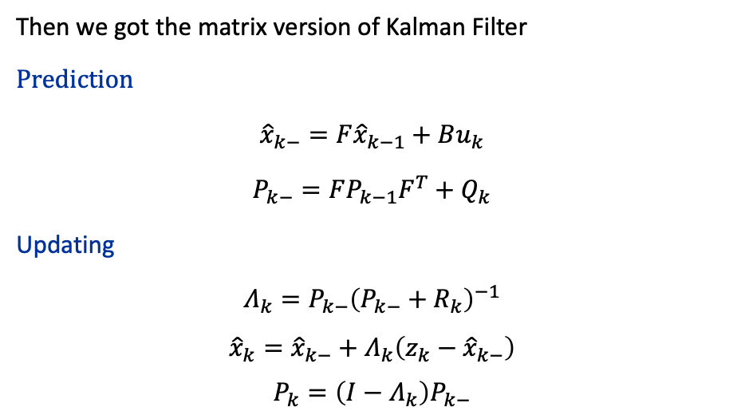
Kalman Filter (Simplified)
Then we got the matrix version of Kalman Filter
Prediction
${\hat{x}}_{k−}=F{\hat{x}}_{k−1}+Bu_{k}$
$P_{k−}=FP_{k−1}F^{T}+Q_{k}$
Updating
$Λ_{k}=P_{k−}{\left(P_{k−}+R_{k}\right)}^{−1}$
${\hat{x}}_{k}={\hat{x}}_{k−}+Λ_{k}\left(z_{k}−{\hat{x}}_{k−}\right)$
$P_{k}=\left(I−Λ_{k}\right)P_{k−}$

Slide 51
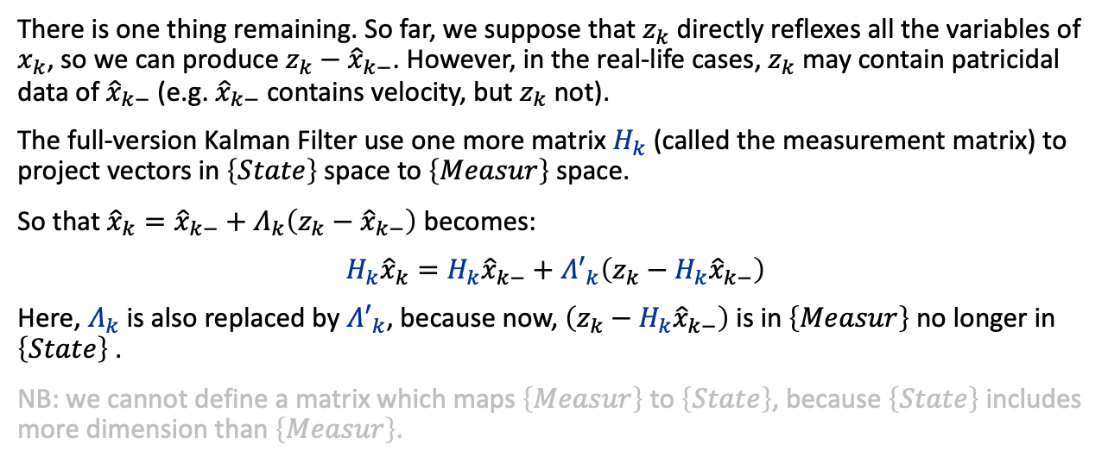
Kalman Filter (full-version)
There is one thing remaining. So far, we suppose that $z_{k}$ directly reflexes all the variables of $x_{k}$, so we can produce $z_{k}−{\hat{x}}_{k−}$. However, in the real-life cases, $z_{k}$ may contain patricidal data of ${\hat{x}}_{k−}$ (e.g. ${\hat{x}}_{k−}$ contains velocity, but $z_{k}$ not).
The full-version Kalman Filter use one more matrix $H_{k}$ (called the measurement matrix) to project vectors in $\left\{State\right\}$ space to $\left\{Measur\right\}$ space.
So that ${\hat{x}}_{k}={\hat{x}}_{k−}+Λ_{k}\left(z_{k}−{\hat{x}}_{k−}\right)$ becomes:
${H_{k}\hat{x}}_{k}={H_{k}\hat{x}}_{k−}+{Λ′}_{k}\left(z_{k}−H_{k}{\hat{x}}_{k−}\right)$
Here, $Λ_{k}$ is also replaced by ${Λ′}_{k}$, because now, $\left(z_{k}−H_{k}{\hat{x}}_{k−}\right)$ is in $\left\{Measur\right\}$ no longer in $\left\{State\right\}$ .
NB: we cannot define a matrix which maps $\left\{Measur\right\}$ to $\left\{State\right\}$, because $\left\{State\right\}$ includes more dimension than $\left\{Measur\right\}$.

Slide 52
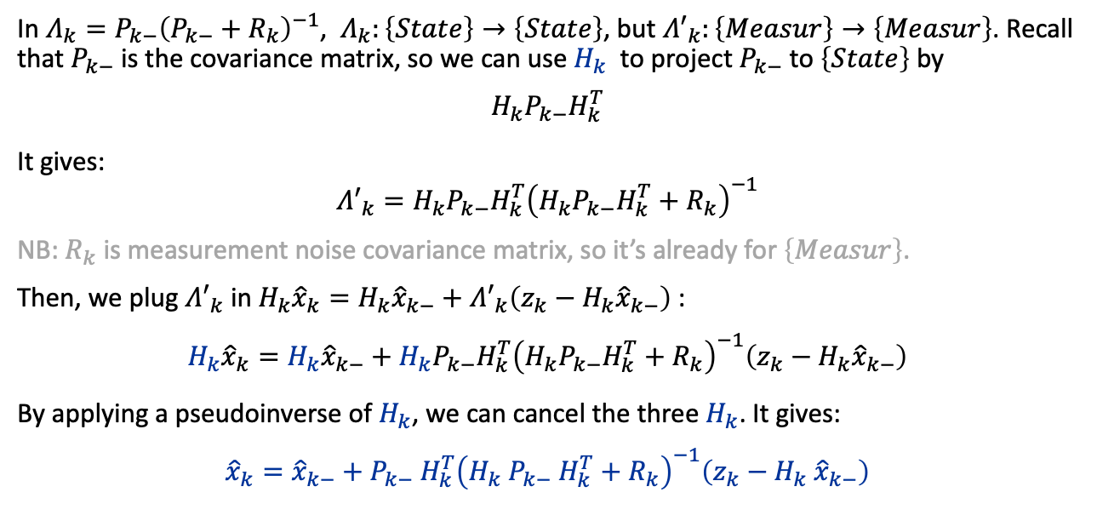
Kalman Filter (full-version)
In $Λ_{k}=P_{k−}{\left(P_{k−}+R_{k}\right)}^{−1}$, $Λ_{k}:\left\{State\right\}→\left\{State\right\}$, but ${Λ′}_{k}:\left\{Measur\right\}→\left\{Measur\right\}$. Recall that $P_{k−}$ is the covariance matrix, so we can use $H_{k}$ to project $P_{k−}$ to $\left\{State\right\}$ by
$$H_{k}P_{k−}H_{k}^{T}$$
It gives:
$${Λ′}_{k}=H_{k}P_{k−}H_{k}^{T}{\left(H_{k}P_{k−}H_{k}^{T}+R_{k}\right)}^{−1}$$
NB: $R_{k}$ is measurement noise covariance matrix, so it’s already for $\left\{Measur\right\}$.
Then, we plug ${Λ′}_{k}$ in ${H_{k}\hat{x}}_{k}={H_{k}\hat{x}}_{k−}+{Λ′}_{k}\left(z_{k}−H_{k}{\hat{x}}_{k−}\right)$:
$${H_{k}\hat{x}}_{k}={H_{k}\hat{x}}_{k−}+H_{k}P_{k−}H_{k}^{T}{\left(H_{k}P_{k−}H_{k}^{T}+R_{k}\right)}^{−1}\left(z_{k}−H_{k}{\hat{x}}_{k−}\right)$$
By applying a pseudoinverse of $H_{k}$, we can cancel the three $H_{k}$. It gives:
$${\hat{x}}_{k}={\hat{x}}_{k−}+P_{k−} H_{k}^{T}{\left(H_{k} P_{k−} H_{k}^{T}+R_{k}\right)}^{−1}\left(z_{k}−H_{k} {\hat{x}}_{k−}\right)$$

Slide 53
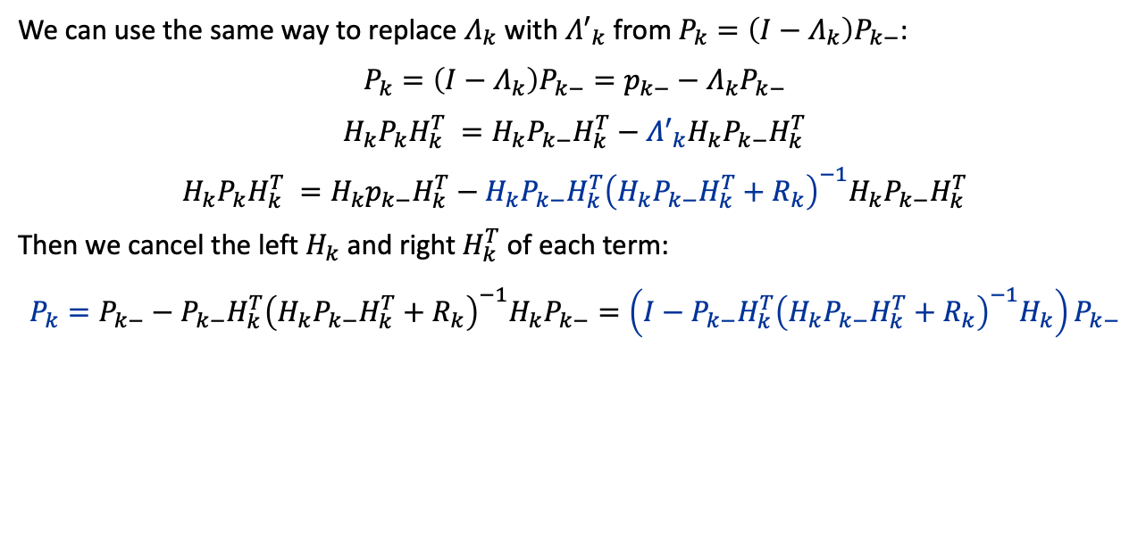
Kalman Filter (full-version)
We can use the same way to replace $Λ_{k}$ with ${Λ′}_{k}$ from $P_{k}=\left(I−Λ_{k}\right)P_{k−}$:
$P_{k}=\left(I−Λ_{k}\right)P_{k−}=p_{k−}−Λ_{k}P_{k−}$
$H_{k}P_{k}H_{k}^{T} =H_{k}P_{k−}H_{k}^{T}−{Λ′}_{k}H_{k}P_{k−}H_{k}^{T}$
$H_{k}P_{k}H_{k}^{T} =H_{k}p_{k−}H_{k}^{T}−H_{k}P_{k−}H_{k}^{T}{\left(H_{k}P_{k−}H_{k}^{T}+R_{k}\right)}^{−1}H_{k}P_{k−}H_{k}^{T}$
Then we cancel the left $H_{k}$ and right $H_{k}^{T}$ of each term:
$$P_{k}=P_{k−}−P_{k−}H_{k}^{T}{\left(H_{k}P_{k−}H_{k}^{T}+R_{k}\right)}^{−1}H_{k}P_{k−}=\left(I−P_{k−}H_{k}^{T}{\left(H_{k}P_{k−}H_{k}^{T}+R_{k}\right)}^{−1}H_{k}\right)P_{k−}$$

Slide 54
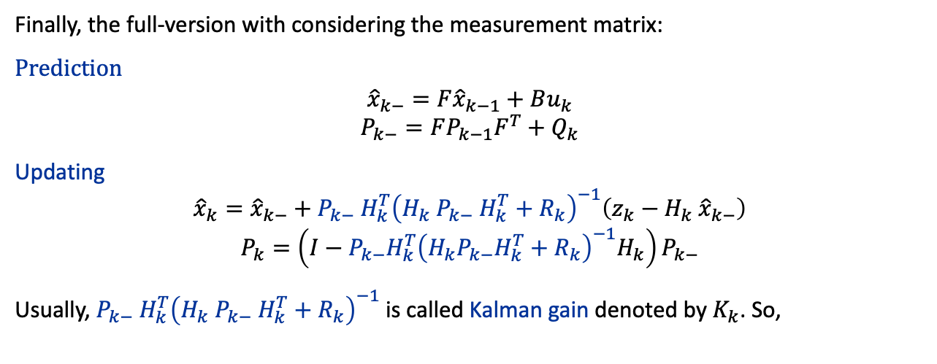
Kalman Filter (full-version)
Finally, the full-version with considering the measurement matrix:
Prediction
$${\hat{x}}_{k−}=F{\hat{x}}_{k−1}+Bu_{k}$$
$$P_{k−}=FP_{k−1}F^{T}+Q_{k}$$
Updating
$${\hat{x}}_{k}={\hat{x}}_{k−}+P_{k−} H_{k}^{T}{\left(H_{k} P_{k−} H_{k}^{T}+R_{k}\right)}^{−1}\left(z_{k}−H_{k} {\hat{x}}_{k−}\right)$$
$$P_{k}=\left(I−P_{k−}H_{k}^{T}{\left(H_{k}P_{k−}H_{k}^{T}+R_{k}\right)}^{−1}H_{k}\right)P_{k−}$$
Usually, $P_{k−} H_{k}^{T}{\left(H_{k} P_{k−} H_{k}^{T}+R_{k}\right)}^{−1}$is called Kalman gain denoted by $K_{k}$. So,

Slide 55
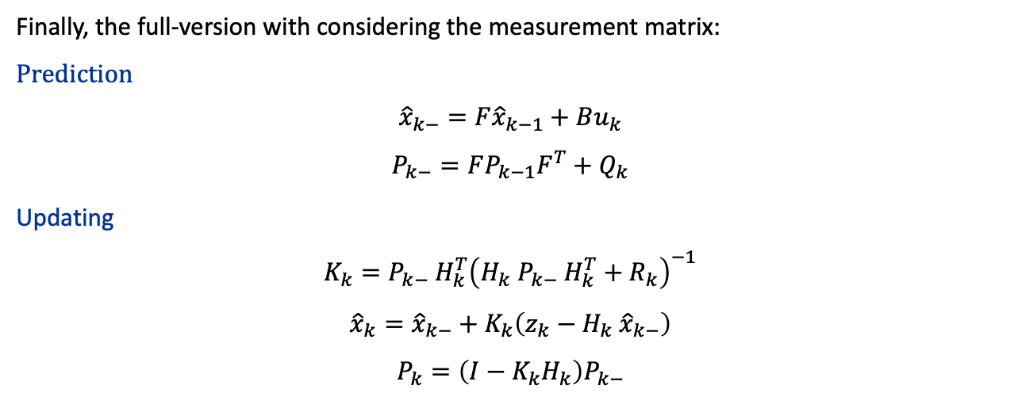
Kalman Filter (full-version)
Finally, the full-version with considering the measurement matrix:
Prediction
$${\hat{x}}_{k−}=F{\hat{x}}_{k−1}+Bu_{k}$$
$$P_{k−}=FP_{k−1}F^{T}+Q_{k}$$
Updating
$$K_{k}=P_{k−} H_{k}^{T}{\left(H_{k} P_{k−} H_{k}^{T}+R_{k}\right)}^{−1}$$
$${\hat{x}}_{k}={\hat{x}}_{k−}+K_{k}\left(z_{k}−H_{k} {\hat{x}}_{k−}\right)$$
$$P_{k}=\left(I−K_{k}H_{k}\right)P_{k−}$$

Slide 56



Kalman Filter
In summary, we started from the 1-D case, then, derived the 1-D case to n-D version. Finally, we introduced the measurement matrix to obtain the common version of Kalman Filter.
1-D version
Prediction
$${\hat{x}}_{k−}=f⋅{\hat{x}}_{k−1}+b⋅u_{k}$$
$$p_{k−}=f^{2}⋅p_{k−1}+q_{k}$$
Updating
$$λ_{k}=p_{k−} / \left(p_{k−}+r_{k}\right)$$
$${\hat{x}}_{k}={\hat{x}}_{k−}+λ_{k}\left(z_{k}−{\hat{x}}_{k−}\right)$$
$$p_{k}=\left(1−λ_{k}\right)p_{k−}$$
n-D version
Prediction
${\hat{x}}_{k−}=F{\hat{x}}_{k−1}+Bu_{k}$
$P_{k−}=FP_{k−1}F^{T}+Q_{k}$
Updating
$Λ_{k}=P_{k−}{\left(P_{k−}+R_{k}\right)}^{−1}$
${\hat{x}}_{k}={\hat{x}}_{k−}+Λ_{k}\left(z_{k}−{\hat{x}}_{k−}\right)$
$P_{k}=\left(I−Λ_{k}\right)p_{k−}$
Kalman Filter
Prediction
$${\hat{x}}_{k−}=F{\hat{x}}_{k−1}+Bu_{k}$$
$$P_{k−}=FP_{k−1}F^{T}+Q_{k}$$
Updating
$$K_{k}=P_{k−} H_{k}^{T}{\left(H_{k} P_{k−} H_{k}^{T}+R_{k}\right)}^{−1}$$
$${\hat{x}}_{k}={\hat{x}}_{k−}+K_{k}\left(z_{k}−H_{k} {\hat{x}}_{k−}\right)$$
$$P_{k}=\left(I−K_{k}H_{k}\right)p_{k−}$$

Slide 57
Conclusion
The primary challenge of localisation in robotics lies in achieving accurate and robust position estimation amidst dynamic environments, sensor noise, and the inherent uncertainty of real-world settings.
The Bayes filter is a probabilistic framework for dynamically updating the estimate of a system's state by combining prior knowledge with observational evidence.
The Particle Filter approximates the posterior distribution of state variables using a set of random samples (particles) and weights.
The Kalman Filter is an optimal recursive data processing algorithm that provides estimates of the internal states of a linear dynamic system from series of noisy measurements.

